Slide 1
Management of MALPRESENTATIONS AND
MALPOSITIONS

Slide 2
objectives
At the end of this session, you able to
Manage malpresentation
Manage malpostion

Slide 3
outline
Introduction
Breech presentation
Face presentation
Brow presentation
Compound presentation
Shoulder presentation
Unstable lie
Cord presentation
Occipito posterior position

Slide 4
Introduction
Malpresentation and malposition are essentially abnormalities of fetal position, presentation, attitude or lie.
They collectively constitute the most common
cause of fetal dystocia occurring in approximately 5% of all pregnancies.

Slide 5
Cont….
About 95% of fetuses at term present by the vertex
in labour and hence is called normal presentation.
When the presentation is other than the vertex,
that is, breech, brow, face or shoulder they are
termed malpresentations.
Position is defined by the relationship of the
denominator of the presenting part to fixed points
of the maternal pelvis.

Slide 6
Cont…
Malposition is more applicable to cases of normal presentation, that is, the vertex.
The vertex presents itself in the occipitoanterior (OA) – (right, left or direct OA) position in about 90% of the cases in the late first stage of labour at term and is called normal position.

Slide 7
MALPRESENTATIONS
Often no cause is identified but any condition that
changes the proportional volume of the fetus and
amniotic fluid resulting in increased or decreased
mobility of the fetus predisposes to malpresentations
These conditions are well known and fall into three major groups. (Fetal factors , Maternal factors and placental factors )

Slide 8
Cont….
1. Fetal factors: fetal anomalies like
hydrocephalus, multiple gestation, prematurity,
Polyhaydraminos and Oligohaydraminos.
2. Maternal factors: uterine anomalies like septate
and bicornuate uterus, contracted pelvis,
submucus myoma, grand multiparity and past
history of malpresentations.
3. Placental factors: placenta previa

Slide 9
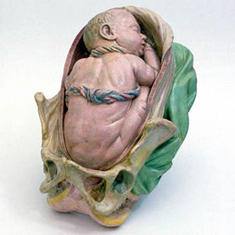
Breech presentation

Slide 10
1. BREECH PRESENTATION
Breech presentation is a fetal presentation where
the fetus lies longitudinally and the buttocks or
the fetal lower extremities occupy the pelvic inlet
with the cephalic pole occupying the fundus.
Incidence depends on the gestational age and the fetal weight.

Slide 11
Cont…
Breech presentation accounts for 3-4% of all
births but occurs in 15% of low birth weight
(<2500gm) infants.
Its incidence in premature fetuses is high and
decreases as gestational age increases.

Slide 12
Risk Factors
prematurity,
uterine abnormalities
fetal abnormalities
multiple gestations.
AF abnormality.
prior breech delivery

Slide 13
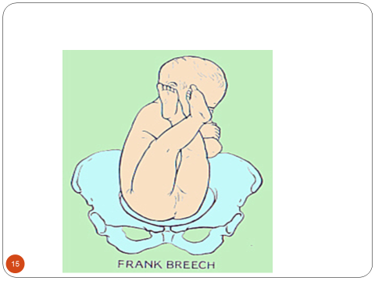
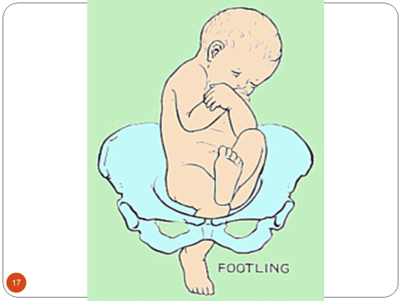
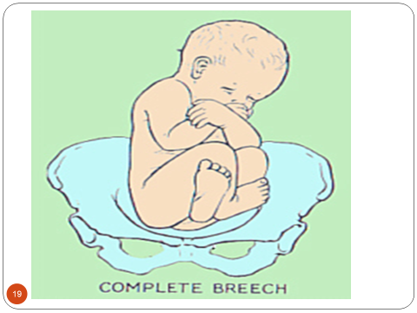
TYPES OF BREECH PRESENTATION

Slide 14
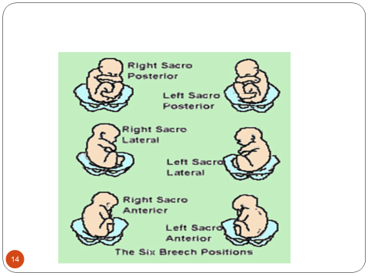
Position of breech presentation

Slide 15
DIAGNOSIS
Palpations and ballottement
Pelvic exam
X-ray studies
Ultrasound

Slide 16
Diagnosis
There are no specific symptoms but occasional
tightness or discomfort in the upper abdomen may be
reported.
Leopould’s maneuver reveals the round, hard,
smooth head occupying the fundus, which will be
ballotable if adequate amniotic fluid is present and
narrow and softer breech occupies the lower pole of
the uterus.
Fetal heartbeat will be heard more easily at or
above the umbilicus.

Slide 17
Cont…
Pelvic examination in labor identifies the soft
irregular mass with anal orifice, the ischial
tuberosities, genital groove and external genitalia.
In footling and complete breech presentation one
or both feet are felt.
The important differential diagnosis at this point is
face presentation which should be differentiated
by the presence of the hard maxilla and if the fetus
is alive the presence of suckling.

Slide 18
Mechanism of labor (frank breech in left sacrotransverse position)
The denominator of breech presentation is the
sacrum and the diameter is bitrochanteric diameter.

Slide 19
Cont…
In labor, the breech engages as the bitrochanteric
diameter passes the plane of the pelvic inlet, usually in one of the oblique diameters.
Decent occurs with further flexion. Internal
rotation ordinarily takes place when breech reaches
levator musculature which brings the bitrochanteric
diameter to anteroposterior position.

Slide 20
Cont…
Further decent with flexion brings the breech to
the pelvic outlet.
Delivery of the buttocks, first the anterior to be
followed by the posterior, occurs by lateral flexion.
As the trunk is delivered the shoulders enter the
pelvic inlet in the transverse diameter causing
rotation of the trunk so that the back faces up.

Slide 21
Cont…
The shoulders descend in the birth canal and at
the level of the pelvic floor internal rotation occur
causing external rotation of the body.
At this point, the back is directed to the left side
of the mother, which indicates readiness for the
delivery of the shoulders.
The shoulders are then delivered by lateral flexion, anterior followed by posterior.

Slide 22
Cont….
At the time the shoulders rotate internally the
head engages in the transverse diameter of the
inlet. The head, after decent rotates internally, at the pelvic floor.
This causes rotation of the rest of the body so
that the back faces up.
Further decent results in the delivery of the head
by flexion (the face sweeps the perineum).

Slide 23
MANAGEMENT
Antepartum
During labor
Delivery

Slide 24
Management
Antepartum management
Breech presentation diagnosed before 32 weeks
of gestation should be managed expectantly with
frequent follow up.
Spontaneous version to cephalic presentation at
the later weeks of gestation is likely.
After 36 weeks the chance of spontaneous
version is less likely.

Slide 25
Cont…
If there are no contraindications external cephalic
version should be performed. This requires expertise
and facilities for emergency cesarean section.
If external cephalic version is contraindicated a
decision on the mode of delivery (vaginal breech
delivery or elective cesarean section) has to be made
before labor starts.
For these reasons pregnant women with breech after
36 weeks have to be referred for hospital management.
Notes:
External cephalic version (definition ,indication,contraindication)

Slide 26
Cont….
II. Intra partum management –Vaginal breech
Delivery
All breech deliveries should ideally be conducted in a
set up with cesarean section facility
In the absence of such facility laboring mothers with
breech presentation in whom delivery is not imminent
(cervical dilatation of less than 8 cm) should be
referred.
Women in whom delivery is imminent should be
attended in the same health facility.

Slide 27
Cont…
This justifies why all health workers dealing with
laboring women need to be skilled in conducting
vaginal breech delivery.

Slide 28
Cont….
Vaginal breech delivery trial should be allowed in:
Estimated fetal weight of less than 3500gms
Frank or complete breech with flexed head
Pelvis should be judged to be adequate with
favorable shape
Live fetus with normal heart rate pattern or
gross malformation or dead fetus

Slide 29
Cont….
Evaluation at admission is like any laboring mother
This confirms the diagnosis and identifies
parameters for allowing vaginal breech delivery.
Artificial rupture of membranes should not be
done.

Slide 30
Cont…..
First Stage of Labour
Careful observation
Warn mother not to push
Vaginal examination should be done and fetal
heart beat checked following spontaneous
rupture of membrane to rule out cord prolapse.
Be prepared for the delivery

Slide 31
Cont….
There is no place of augmentation of breech Presentation.
The mother should be instructed not to push till
full cervical dilatation is achieved.

Slide 32
Cont…..
In the second stage of labor, before conducting
delivery, pelvic examination should be done to
confirm full cervical dilatation.
Bladder must be emptied and the mother
positioned in lithotomy position.

Slide 33
Types of breach delivery
1. Spontaneous breach delivery
May need little assistant with the attendant
2. Assisted breach delivery
Assistance is needed (necessary) for the delivery of extended leg, arms & head.
3. Breach Extraction
This is manipulative delivery carried out by
obstetrician & performed to hasten delivery in an
emergency situation such as fetal distress.

Slide 34
Cont…
1. Spontaneous vaginal breech delivery where
the infant is expelled entirely spontaneously
without any help other than support.
This occurs rarely except for premature babies
in a multipara.
It is associated with higher perinatal mortality.

Slide 35
Cont….
2. Assisted vaginal breech delivery (Partial
breech extraction) where the fetus is delivered up
to the level of the umbilicus spontaneously and the
rest of the body is delivered with the assistance of
the health professional using special maneuvers.

Slide 36
Cont…
3. Total breech extraction where the entire fetus
is delivered from the birth canal by the assistance of the health professional.
It is associated with significant maternal and fetal
risks. This procedure is only performed for the
delivery of the second twin.
Third stage is managed actively and the genital
tract explored for tears.

Slide 37
Techniques of assisted breech delivery
Delivery of the buttocks and legs
Instruct the mother to bear down with every
contraction.
Do episiotomy when the fetal anus is visible and
perineum distended.
Allow the breech to be delivered with out
intervention up to the level of the umbilicus.
After the delivery of the buttocks, supporting the
baby around the hips without pulling and keeping it
below the horizontal is all that is needed.

Slide 38
Cont…
The baby should be grasped with clean towel
moistened with warm water.
Holding the baby around the hips avoids fetal
visceral damage.
Ensure the anterior position of the sacrum and
the back until the lower border of the scapula is
visible.

Slide 39
Cont…
In frank breech, if the legs can not be delivered
spontaneously, it can be assisted by splinting the
medial thigh of the fetus with the position
parallel to the femur and exerting pressure
laterally so as to sweep the legs away from the
midline (Pinnard maneuver).

Slide 40
Cont.….
B. Delivery of the arms and shoulders
After the lower border of the scapula is visible pull
a length of umbilical cord.
Ensure the back is facing to the right or left side
before delivering the arms.
Introduce two fingers into the vagina over the chest
of the fetus and feel for both arms. If the arms are
not felt it indicates extended or nuchal arm.
If the arms can’t be delivered spontaneously, deliver
the arms in one of the following ways:

Slide 41
Cont.
Lovset maneuver
Holding the baby’s hip rotate the fetus by half a
circle (180 degree) keeping the back uppermost and applying downward traction at the same time.
This delivers the posterior arm, which now
becomes the anterior arm, beneath the pubic arch.
This may be assisted by placing one or two fingers on the upper part of the arm flexing it, which sweeps the arm over the chest.

Slide 42
Cont….
Then reverse the rotation (half a circle (180 degree) keeping the back upper most to deliver the remaining arm beneath the symphysis.

Slide 43
II. Delivery of the posterior arm followed by anterior (or the reverse)
Put one or two fingers into the vagina over the
back of the baby.
Slip the fingers over the shoulders, place them
parallel to the humerus and apply downward
pressure to deliver the arm.

Slide 44
Cont…
III. Extraction of the posterior arm
- It is useful when there is extended arm and the
Lovset maneuver is not successful.

Slide 45
Cont…
C. Delivery of the head
Allow the baby to hang until the nape of the neck
or posterior hairline is visible. Then deliver the
head in one of the following ways:-
Mauriceau Smellie Veit maneuver
- Introduce the non-dominant hand into the vagina
over the face of the fetus which is supported
by the forearm.

Slide 46
Cont…
Place the first (index) and the third (ring) fingers on the
right and left cheek bones and place the second
(middle) finger into the baby’s mouth. The fingers are
applied to the maxilla to flex the head.
At the same time introduce the dominant hand into
the vagina over the back of the fetus.
Put the first and third fingers over the shoulders and
the middle finger over the occipital prominence. Press
down on the occiput to assist flexion of the head.

Slide 47
Cont…
Ask an assistant to apply gentle supra pubic
pressure by the base of the hand.
Pull gently to deliver the head by making an arc
following the pelvic curve.

Slide 48
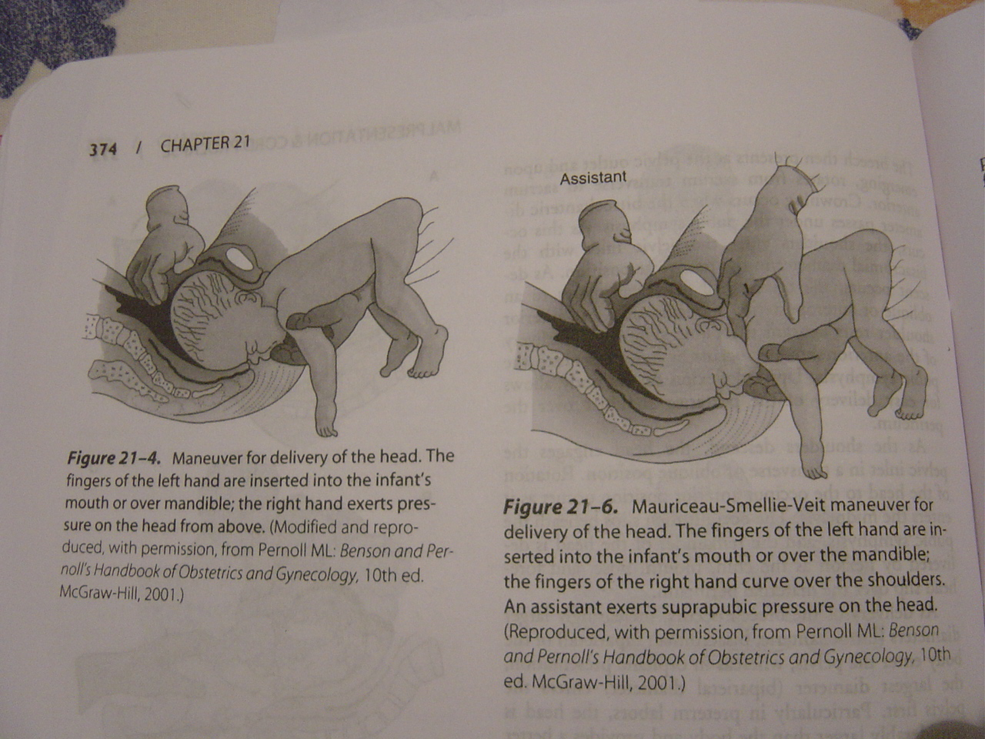
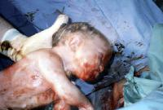
Picture 12. Assisted vaginal breech delivery - The neonate after birth

Slide 49
Con.
2. Burn marshal methode - delivery of flexed head
Grasp the baby’s ankle by the left hand from behind with fore finger b/n the two.
The baby is kept in the stretch with sufficient traction to prevent his neck from bending back ward & being fracture

Slide 50
Cont…
3. Wigand maneuver
The procedure is like Mauriceau SmellieVeit
maneuvers but differs by
The dominant hand instead of being introduced
into the vagina it is put on the supra pubic area
to provide supra pubic pressure.
An assistant is not needed to apply supra pubic
pressure.
4. By Pipers forceps

Slide 51
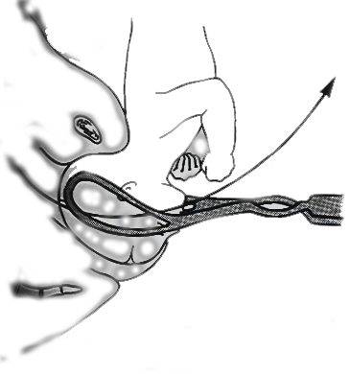
Forceps for the after coming head

Slide 52
5. Modified Prague Maneuver
the back of the fetus fails to rotate to the anterior
consists of two fingers of one hand grasping the shoulders of the back-down fetus from below while the other hand draws the feet up and over the maternal abdomen.

Slide 53
Complication
Breech presentation is associated with high
perinatal morbidity and mortality.
Possible complications contributing to maternal
mortality and morbidity are obstructed labor,
genital tract lacerations and increased risk of
operative delivery.

Slide 54
Cont.…
Fetal complications are :-
Cord prolapse
Cerebral damage due to hypoxia
Prematurity
Intracranial hemorrhage due to trauma
Injuries to liver, spleen, adrenal glands or kidney
Erb’s palsy due to damage of the brachial plexus

Slide 55
Cont…
Facial nerve paralysis due to the twisting of the
neck.
Fracture to femur, tibia, humorous or clavicle
Damage to spinal cord due to wrong handling

Slide 56

Face presentation

Slide 57
2. FACE PRESENTATION
Face presentation is a kind of cephalic presentation where the neck of the fetus is fully extended so that the occiput lies on the back which results in the face to present to the pelvic canal.
With this presentation, the head is hyperextended so that the occiput is in contact with the fetal back, and the chin (mentum) is presenting

Slide 58
Cont…
The fetal face may present with the chin (mentum) anteriorly or posteriorly, relative to the maternal symphysis pubis.
It is a rare condition occurring in 1 in 550 births.

Slide 59
Risk factor
Lax uterus,
Multiple pregnancy
Hydraminous
Deflexed fetal head
High multiparity
Anencephaly
Abnormal shape of pelvis
prematurity

Slide 60
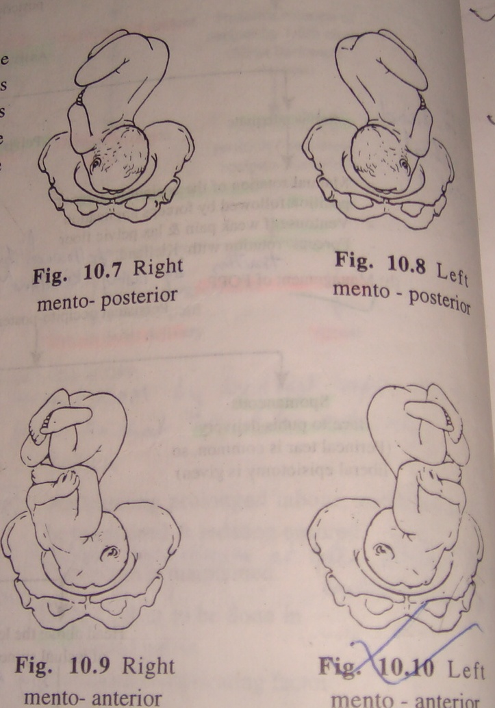

Slide 61
Diagnosis
Antenatal diagnosis is often difficult.
Diagnosis is usually made in labor by vaginal examination.
Diagnosis by Leopold maneuver is based on finding long ovoid uterus with no bulges in the flanks, S shaped ill defined fetal back with marked depression between the occiput and the back, and palpation of the cephalic prominence on the same side as the fetal back.

Slide 62
Cont….
Fetal heart beat is heard on the side of the feet in
mento transverse and difficult to identify in
mentoposterior.
On vaginal examination, with sufficiently dilated
cervix, feeling the orbital ridges, eyes, nose and
mouth clinches the diagnosis.

Slide 63
Cont…
Confusion may arise with breech presentation in
prolonged labor with edema of the presenting
part.
The mouth may be open and the hard gums are
diagnostic and the fetus may suck the examining
finger.

Slide 64
Mechanism of labor
The denominator is the mentum (chin).
The presenting diameter is submentobregmatic
which is 9.5 centimeters.
Eight possible positions exist depending on the
relation of the chin to the various quadrants of the
pelvis.

Slide 65
Cont…
Engagement occurs when the submento-bregmatic diameter passes the pelvic inlet.
Decent with extension of the head occurs.
At the pelvic floor internal rotation occurs.
In most cases rotation of the chin occurs anteriorly so that the fetus assumes mentoanterior position.
In few, the chin rotates towards the sacrum assuming persistent mentoposterior position.

Slide 66
Cont…
For mentoanterior further decent with extension
occurs till it reaches the perineum.
Delivery occurs by flexion so that the sinciput,
vertex and the occiput sweep the perineum.
Restitution, external rotation and delivery of the
shoulders by lateral flexion occur in the same
manner as vertex presentation.

Slide 67
Cont…
In persistent mentoposterior, there is no
mechanism of labor. Unless relieved, further
impaction results in obstructed labor.

Slide 68
Management of labor
Cesarean section is indicated in the presence of
big baby, contracted pelvis, previous uterine
scar like previous cesarean section and a woman
with bad obstetric history.
Persistent mentoposterior position, poor progress of labor and fetal distress are indications for cesarean section.

Slide 69
Cont….
Appropriate evaluation before or at the start of
labor and proper follow up of labor is, therefore,
essential.

Slide 70
Cont…..
Follow up in the first stage of labor is like in vertex
presentation.
Labor may be slow but as long as it is progressing nothing special need to be done. The old saying "if a face is progressing leave it alone” is still valid.
Augmentation of labor is generally contraindicated.
Low forceps may be needed for mentoanterior
position in prolonged second stage.

Slide 71
Complications
Cord prolapse
Facial bruising and swelling which disappear in one week and 1-2 days respectively.
Cerebral hemorrhage,
Extensive perineal lacerations,
Increased operative delivery and obstructed labor.

Slide 72
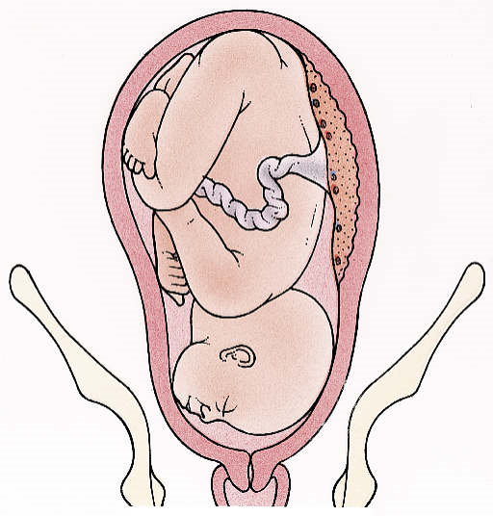
Brow presentation

Slide 73
3. BROW PRESENTATION
This rare presentation is diagnosed when that
portion of the fetal head between the orbital ridge
and the anterior fontanel presents at the pelvic inlet.
Brow presentation is a form of cephalic
presentation in which there is partial extension
of the fetal head so that the brow (area between
the anterior fontanel and the orbital ridges)
becomes the presenting part.

Slide 74
Cont….
the fetal head thus occupies a position midway between full flexion (occiput) and extension (face).
-Except when the fetal head is small or the pelvis
is unusually large, engagement of the fetal head
and subsequent delivery cannot take place as
long as the brow presentation persists.
It occurs in 0.06 % of deliveries

Slide 75
Risk factors
1. Lax uterus,
2.Multiple pregnancy,
3.Hydraminous
4. Deflexed fetal head
- Hypotonus of the neck muscle
- Thyroid tumor
5. Anencephaly
6.Abnormal shape of pelvis

Slide 76
Diagnosis
Diagnosis by abdominal palpation is possible but
unusual.
Usually, diagnosis is made late in labor.
Finding the frontal suture, large anterior fontanel,the orbital ridges and the base of the nose on vaginal examination with dilated cervix clinches the diagnosis but neither the mouth nor the chin is palpable.

Slide 77
Mechanism of labor
The denominator is the anterior fontanel or the
frontal bone.
The presenting diameter is mentovertical which is 13.5 centimeters.
Engagement does not occur as this diameter is larger than the diameters of the pelvic inlet.
Unless it reverts to either face or vertex presentation, there is no mechanism of labor for brow presentation.

Slide 78
Cont…
Spontaneous delivery of a term brow is unlikely.
If no intervention is made the end result is
obstructed labor.

Slide 79
Management
In the absence of other conditions that mandate
cesarean section, determination of the pelvic
capacity and fetal size must be made.
o Emergency cesarean section is indicated for
macrosomia and contracted pelvis.

Slide 80
Cont…
In early labor, in the absence of such conditions,
management is expectant. This is based on the
assumption that a brow may spontaneously revert to face or vertex, which occurs in 30 % of the cases.
If it persists, the fetus has to be delivered by cesarean section.
Augmentation of labor for arrested labor is not
recommended.

Slide 81
4. COMPOUND PRESENTATION
Compound presentation is a presentation in
which an extremity (hand or foot) prolapses or
descends along side of the presenting part.
The most common type is upper extremity
prolapsing with vertex. Other varieties are upper
extremity with breech or rarely lower extremity
with vertex.
Incidence is 1 in 1000 pregnancies.

Slide 82
Causes
Obstetric factors that prevent descent of the
presenting part into the pelvic inlet predispose to
prolapse of an extremity alongside the presenting
part (i.e, prematurity, cephalopelvic
disproportion, multiple gestation, grand
multiparity, and hydramnios).

Slide 83
Cont….
Prematurity occurs in over 50% of compound
presentations.
In twin gestations, over 90% of compound
presentations are associated with the second twin.

Slide 84
Diagnosis
Is made on vaginal examination in labor by
palpating fetal extremity adjacent to the presenting
part.
The diagnosis is usually made during labor; as the
cervix dilates, the prolapsed extremity is more easily
palpated alongside the vertex or breech.
Compound presentation may be suspected if poor
progress in labor is noted, particularly when the
presenting part fails to engage during the active
phase.

Slide 85
Cont….
If diagnosis is suspected but uncertain, ultrasound or X-ray can be used to locate the position of the extremities and search for malformations.

Slide 86
Management
Management depends on –
Gestational age,
Type of presentation and whether the hand or
foot is prolapsing.

Slide 87
Cont….
Viability of the fetus should be documented prior
to delivery since compound presentation is associated with prematurity.
Labor should be allowed and delivery anticipated, if the fetus is considered non-viable (<28 weeks according to our country's protocol), has gross congenital malformation or is dead.

Slide 88
Cont…
In viable fetus, if hand is prolapsing with vertex,
labor could be allowed to continue with the hope of
spontaneous retraction of the hand as labor
progresses.
Any attempt to reduce the extremity by digital
manipulation is contraindicated. Persistent cases
should under go cesarean section.
Vertex with foot and breech with hand are
indications for cesarean section.

Slide 89
Cont…
In most cases, the prolapsed part should be left
alone, because most often it will not interfere with
labor.
If the arm is prolapsed alongside the head, the
condition should be observed closely to ascertain
whether the arm retracts out of the way with
descent of the presenting part.

Slide 90
Cont…
If it fails to retract and if it appears to prevent
descent of the head, the prolapsed arm should be
pushed gently upward and the head simultaneously
downward by fundal pressure.

Slide 91
5. SHOULDER PRESENTATION
Shoulder presentation is a presentation in which the
long axis of the fetus is at right angles to the axis of the
uterus so that the presenting part becomes the shoulder.
A transverse lie becomes a shoulder presentation in labour.
It is the most dangerous of the fetal presentations.
Incidence is 1:300 deliveries at term but is higher in
preterm birth.

Slide 92
Risk factors
Laxity of uterus
Placenta previa,
Hydraminous,
Multiple pregnancy
Uterine abnormality
Prematurity
Contracted pelvis

Slide 93
Diagnosis
transversely oval with the fundus scarcely above the umbilicus.
The fundal height is less than expected for the
period of gestation.
There is no fetal pole in the fundus and the pelvic
inlet.

Slide 94
Cont…
A very high and unreachable presenting part on
vaginal examination highly suggests transverse lie.
Ultrasound confirms the diagnosis and identifies
the possible causes.
In labor vaginal examination identifies the
shoulders and/or the ribs or in neglected cases the
hand prolapsing through the vulva.

Slide 95
Mechanism of labor
Spontaneous delivery of a fully developed newborn is impossible with a persistent transverse lie.
After rupture of the membranes, if labor continues, the fetal shoulder is forced into the pelvis, and the corresponding arm frequently prolapses.
After some descent, the shoulder is arrested by the margins of the pelvic inlet, with the head in one iliac fossa and the breech in the other

Slide 96
Cont…
As labor continues, the shoulder is impacted firmly in the upper part of the pelvis.
The uterus then contracts vigorously in an
unsuccessful attempt to overcome the obstacle.
With time, a retraction ring rises increasingly higher
and becomes more marked. With this neglected
transverse lie, the uterus will eventually rupture.

Slide 97
Management
When diagnosed at antenatal clinic after 36 weeks external version will be attempted.
In labour cesarean section is method of choice
when attempt of external version have failed.
When membrane have ruptured before; if there is
cord prolapses if arm prolapses even with dead fetus cesarean section is mandatory.

Slide 98
Complication
Maternal
Obstructed labour
Uterine rupture
Puerperal sepsis
PPH
Fetal
Fetal death (cord
prolapsed)
Malformation
Arm prolapse

Slide 99
6. Unstable lie
When the lie is found to vary, breech, vertex or
shoulder, presenting from one examination to
another after 36th weeks of pregnancy.

Slide 100
Risk factors
- Lax uterine muscles
- Multiparity
- Polyhydraminous

Slide 101
Management
Admission in hospital at the 36-37 week and
remain in the hospital until delivery.
Attempts are made by the obstetrician to correct
the abnormal presentation by external version. If
unsuccessful, cesarean section is considered.
Some times AROM is done after correcting the
transverse lie to ensure that the woman goes into
labour with vertex presentation.

Slide 102
Cont….
An oxytocic drip is usually given after version.
Extreme caution and close observation is mandatory throughout labour.
Monitoring of Fetal Heart Beat frequently is very
important.
The bladder and the rectum should be emptied -
preservation of the longitudinal lie.

Slide 103
7. UMBILICAL CORD PRESENTATION AND
PROLAPSE
It is decent of the umbilical cord into the lower
uterine segment.
Prolapse of the umbilical cord to a level at or
below the presenting part exposes the cord to
intermittent compression between the presenting
part and the pelvic inlet, cervix, or vaginal canal.

Slide 104
Cont…
Compression of the umbilical cord compromises
fetal circulation and, depending on the duration
and intensity of compression, may lead to fetal
hypoxia, brain damage, and death.

Slide 105
Cont….
It may take the following forms:
Overt cord prolapse: presentation of the cord
beyond the cervix after rupture of the membranes, so
that loop of cod is palpable or visible during
examination.
Occult cord prolapse: with ruptured membranes
the cord has prolapsed along side the presenting part
but not in front of it. This is not palpable during vaginal
examination.

Slide 106
Cont…
Cord presentation: the cord is in front of the
presenting part with intact membranes so that it is
felt through the membranes during vaginal
examination.

Slide 107
Incidence
Incidence varies with the type of presentation.
For overt cord prolapse it is 0.5% in cephalic,
0.5% in frank breech, 5 % in complete breech, 15 % in footling breech and 20% in transverse lie.
The incidence of occult prolapse is unknown
because it can be detected only by fetal heart rate
changes characteristic of umbilical cord
compression.

Slide 108
Causes
Any obstetric condition that predisposes to poor
application of the fetal presenting part to the cervix
can result in prolapse of the umbilical cord.
Cord prolapse is associated with prematurity (<
34 weeks' gestation), abnormal presentations
(breech, brow, compound, face, transverse), occiput posterior positions of the head, pelvic tumors, multiparity, placenta previa,, and cephalopelvic disproportion.

Slide 109
Cont….
In addition, cord prolapse is possible with
hydramnios, multiple gestation, or premature
rupture of the membranes occurring before
engagement of the presenting part.

Slide 110
Diagnosis
Overt cord prolapse can be diagnosed simply by
visualizing the cord protruding from the introitus or
by palpating loops of cord in the vaginal canal.
The diagnosis of funic presentation is made by
pelvic examination if loops of cord are palpated
through the membranes.

Slide 111
Cont…
Occult prolapse is rarely palpated during pelvic
examination.
This condition can be inferred only if fetal heart
rate changes (variable decelerations, bradycardia, or both) associated with intermittent compression of
the umbilical cord are detected during monitoring.

Slide 112
Cont…
Variable fetal heart rate decelerations will occur
during uterine contractions, with prompt return
of the heart rate to normal as each contraction
subsides.
If cord compression is complete and prolonged,
fetal bradycardia occurs.
Persistent, severe, variable decelerations and
bradycardia lead to development of hypoxia,
metabolic acidosis, and eventual damage or
death.

Slide 113
Cont…
As the fetal status deteriorates, activity lessens and eventually ceases.
Meconium staining of the amniotic fluid may
be noted at the time of membrane rupture.

Slide 114
Management
Overt Cord Prolapse
The diagnosis of overt cord prolapse demands
immediate action to preserve the life of the fetus.
It depends on presence of cord pulsation and
cervical dilatation.
If there is no pulsation await spontaneous delivery
with or without destructive delivery.

Slide 115
Cont…
- If pulsations are felt deliver by the fastest route
(cesarean section if cervix is not fully dilated,
instrumental delivery if it is cephalic and cervix is
fully dilated, total breech extraction if breech and
cervix is fully dilated).
Alternatively, 400–700 mL of saline can be instilled into the bladder in order to elevate the presenting part.

Slide 116
Cont….
Note: If fetus is viable (FHB positive and cord
pulsating) until the patient is ready for cesarean
section put the patient in knee-chest position,
apply continuous up ward pressure against
presenting part, put the cord inside the vagina and
give oxygen to the mother.

Slide 117
Occult Cord Prolapse
If cord compression patterns (variable
decelerations) of the fetal heart rate are recognized
during labor, an immediate pelvic examination should be performed to rule out overt cord prolapse.
If occult cord prolapse is suspected, the patient
should be placed in the lateral Sims or Trendelenburg position in an attempt to alleviate cord compression.

Slide 118
Cont….
If the fetal heart rate returns to normal, labor can
be allowed to continue, provided no further fetal
insult occurs.
Oxygen should be administered to the mother, and the fetal heart rate should be continuously
monitored electronically.

Slide 119
Cont….
Amnioinfusion can be performed via an
intrauterine pressure catheter in order to instill
fluid within the uterine cavity and possibly decrease
the incidence of variable decelerations.

Slide 120
Cont….
If the cord compression pattern persists or
recurs to the point of fetal jeopardy a rapid cesarean section should be accomplished.

Slide 121
Funic Presentation
The patient at term with funic presentation should be delivered by cesarean section prior to membrane rupture. However, there is no consensus on management if the fetus is premature.
The most conservative approach is to hospitalize
the patient on bed rest in the Sims or Trendelenburg position in an attempt to reposition the cord within the uterine cavity.

Slide 122
Cont.….
Serial ultrasonographic examinations should be
performed to ascertain cord position, presentation,
and gestational age.

Slide 123
Complication
Maternal
Cesarean section is a major operative procedure
with known anesthetic, hemorrhagic, and operative
complications. These risks must be weighed against the real risk to the fetus of continued hypoxia if labor were to continue.
Maternal risks encountered at vaginal delivery
include laceration of the cervix, vagina, or perineum
resulting from a hastily performed delivery.

Slide 124
Cont….
Neonatal
The neonate at delivery may be hypoxic, acidotic,
or moribund.
A pediatric team should be present to effect
immediate resuscitation of the newborn.

Slide 125
Prevention and early detection
Artificial rupture of membranes should be avoided
until the presenting part is well applied to the cervix.
After spontaneous or artificial rupture of membranes, careful and prompt pelvic examination should be done to rule out cord prolapse.
Before doing ARM, check for the presence of cord.

Slide 126
Prognosis
Maternal
Maternal complications include those related to
anesthesia, blood loss, and infection following
cesarean section or operative vaginal delivery.
Maternal recovery is generally complete.

Slide 127
Neonatal
Although the prognosis for intrapartum cord
prolapse is greatly improved, fetal mortality and
morbidity rates still can be high, depending on the
degree and duration of umbilical cord compression
occurring before the diagnosis is made and neonatal resuscitation is started.
If the diagnosis is made early and the duration of
complete cord occlusion is less than 5 minutes, the
prognosis is good.

Slide 128
Cont….
Gestational age and trauma at delivery also affect
the final neonatal outcome.
If complete cord occlusion has occurred for longer than 5 minutes or if intermittent partial cord
occlusion has occurred over a prolonged period of
time, fetal damage or death may occur.

Slide 129
Occipito posterior position (OP)
It is a vertex presentation in which the occiput is
placed posteriorly . It can be:-
1. Right occipto-posterior (the commonest)
2. Left occipto-posterior.
3. Direct occipto-posterior
In 20% of cases the occipt is posterior at the
beginning of labour .

Slide 130
When the head is presented with vertex posterior “OP” it will be deflexed and the longitudinal diameters will be change to:
Sub-occipito frontal 10.5cm
Or
Occipito frontal 11.5cm

Slide 131
Risk factors
1. Pelvic Factors:- 50% of cases are associated with anthropoid pelvis or android pelvis .
2.Fetal Factors:- Marked deflection of the fetal head
3.Uterine Factor:- Abnormal uterine contraction
which may be the cause or effect .

Slide 132
Diagnosis
Features suggesting the diagnosis include :-
- Backache during labour
- Flattening of the abdomen below the umbilicus .
-The fetal limbs are more easily felt near the midline
on both side .
-The head in unengaged and feel larger than usual.

Slide 133
Cont….
vaginal examination :-
- Elongated bag of membrane which is likely to
rupture early .
- High deflexed head with the anterior fontanelle in
the center of the pelvis .

Slide 134
Mechanism of Labour
First and second stage of labour usually prolonged .
- Membrane usually rupture early with the hazards of
cord prolapse and infection .
-In favorable circumstances (90% of cases) good uterine contraction result in good flexion of the head and the occiput rotates 3/8 of the circle (135c0 ) anteriorly and deliver as occipto-anterior position .
- In unfavorable circumstances (10% of cases) the
occiput

Slide 135
Cont….
1. Fail to rotate and remain in the oblique diameter of
the pelvis .
2. Rotate anteriorly 1/8th of circle (short rotation) and
the head become arrested in the transverse diameter
of the pelvis (deep transverse arrest) .
3. Rotate posterioly 1/8th of the circle to lie on the sacral hollow this called direct-occipto- posterior position. And if the fetus is small & pelvis is adequate
spontenous delivery can occur as face to pubic .

Slide 136
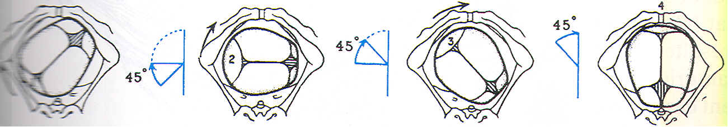
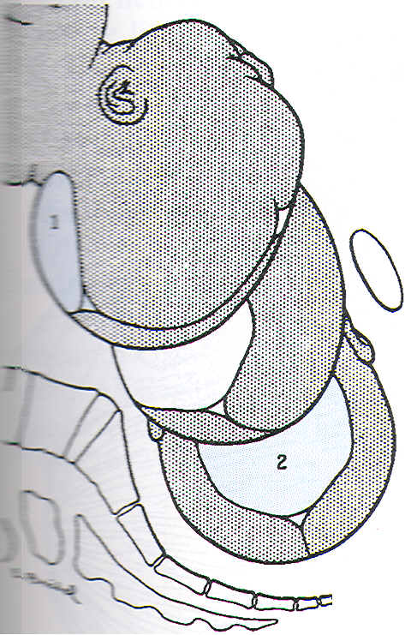
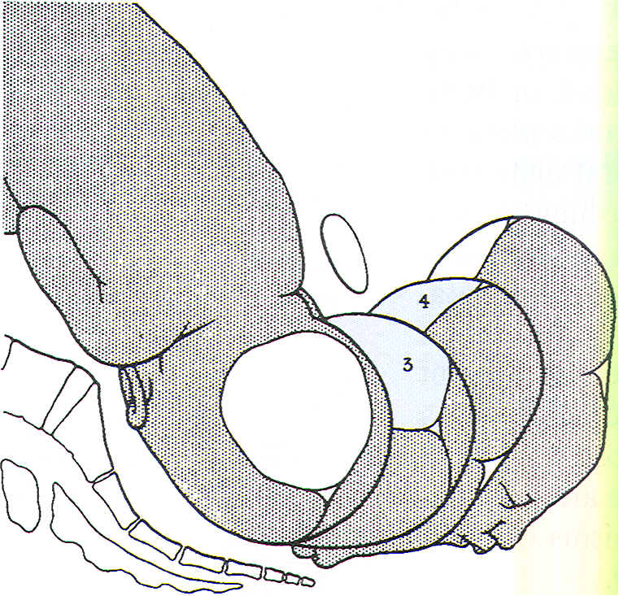
Mechanism of labor for right occiputo posterior position, anterior rotation.
,.
,0

Slide 137
Management
Unless there is fetal hypoxia or other complication
labour is allowed to proceed with the following
special instructions .
- Provide adequate analgesia (an epidural is ideal).
- Prevent dehydration with intravenous fluid glucose
-You may need to promote uterine contraction with
oxytocin .
- Good monitoring for progress of labour ,fetal
condition and maternal condition .

Slide 138
Cont….
-In the majority of cases anterior rotation of the
occipt is completed and the baby is delivered as
occipto-anterior.
-Indirect occipto-posterior delivery as face to pubis
may occur ,the perineum should be protected by a
generous episiotomy .

Slide 139
Cont….
Persistent– occipto posterior and deep transverse arrest
-If the fetal head is not engaged caesarian section is the treatment of choice .
-If the fetal head is engaged the treatment will be one of the following .
1) Manual rotation and delivery by forceps as occipto anterior.

Slide 140
Cont….
2) Rotation to occipto-anterior and extraction using
kielland’s forceps .
3) Ventouse (vacuum extraction).
4) Caesarean section if the above lines of treatment
fail or there is other complicating factor .
5) Craniotomy when the fetus is dead .

Slide 141
Referances
William obs 24th edition
current gyniobs 10th edition

Slide 142
Thank you!

