Slide 1
Labor and delivery module for Generic BSc Midwifery program in Ethiopia
Module Name: Labor and Delivery
Module Code: MidwM-3121
Part II: Week 5-8

Slide 2
Learning outcomes (1 of 3)
This PowerPoint presentation is prepared based on national harmonized BSc in Midwifery curriculum in Ethiopia. It is ready for self learning to help BSc in Midwifery students acquire knowledge of labor and delivery. The material mainly addresses knowledge components and cognitive level skills of learning outcomes of contents in 5th week through 8th week of presentation in the curriculum. Learning outcomes are listed below and accordingly, students are expected to achieve them at the end of this presentation.

Slide 3
Learning outcomes (2 of 3)
Differentiate abnormal patterns of labor in each stage (K )
Identify abnormal labour patterns in each stages of labor and initiate appropriate and timely intervention and/or referral (S)
Identify indication for induction and augmentation of labor (K)
Perform induction and augmentation of labor (S)
Perform induction and augmentation of labor (S)
Identify cephalopelvic disproportion(K)

Slide 4
Learning outcomes (3 of 3)
Manage or refer obstructed labor (S)
Identify risks for obstetric fistula and provide care for women with obstetric fistula (K)
Assess mal-presentation and malposition (K)
Manage mal-presentation and malposition using appropriate manoeuvres (S)
Distinguish complications of third stages of labor (K)
Manage complications of third stages of labor (retained conceptus tissue, atonic uterus, tears) (S)

Slide 5
Presentation outline (1 of 2)
Abnormal labor
  Prolonged latent phase
  Protraction and arrest disorders
  Precipitate labor
Non-reassuring fetal heart rate pattern
Obstructed labor
Induction and Augmentation of labor
Abnormalities of passage

Slide 6
Presentation outline (2 of 2)
Abnormalities of passenger
  Introduction, diagnosis and management of: (Malposition, Mal-presentation, Fetal Macrosomia, and Fetal malformation)
Complications of third stages of labor
  Post-partum hemorrhage
Week 9 through 14 will be continued in part III presentation

Slide 7
Abnormal labor
Labor refers to:
  uterine contractions resulting in progressive dilation and effacement of the cervix
  accompanied by descent and expulsion of the fetus
Abnormal labor, dystocia, and failure to progress
  protraction disorders (ie, slower than normal progress) or
  arrest disorders (ie, complete cessation of progress)

Slide 8
Dystocia (1 of 3)
Dystocia is the consequence of four distinct abnormalities:
    that may exist singly or in combination:
  Abnormalities of the expulsive forces
    uterine forces insufficiently
    inappropriately coordinated
    inadequate voluntary muscle effort during the second stage of labor

Slide 9
Dystocia (2 of 3)
  Dystocia is the consequence of four distinct abnormalities:
  Abnormalities of presentation, position, or development of the fetus
  Abnormalities of the maternal bony pelvis—that is, pelvic contraction
  Abnormalities of soft tissues of the reproductive tract that form an obstacle to fetal descent

Slide 10
Dystocia (3 of 3)
these abnormalities can be mechanistically simplified into three categories:
  Abnormalities of the powers—uterine contractility and maternal expulsive effort
  Abnormalities involving the passenger—the fetus
  Abnormalities of the passage—the pelvis

Slide 11
Abnormal labor
Friedman described four abnormal patterns of labor:
  prolonged latent phase
  protraction disorders (protracted active-phase dilatation and protracted descent)
  arrest disorders (arrest of dilatation, arrest of descent, and failure of descent)
  precipitate labor disorders

Slide 12
Abnormal labor
prolonged latent phase
  from the onset of regular uterine contractions to the beginning of the active phase of cervical dilatation (4 cm)
  latent phase averages 6.4 hours in nulliparas and 4.8 hours in multiparas
  abnormally prolonged
    more than 20 hours in nulliparas or 14 hours in multiparas

Slide 13
Abnormal labor
prolonged latent phase
  Causes:
    excessive sedation
    use of conduction or general anesthesia
    labor induction with an unfavorable cervix
    uterine dysfunction characterized by:
      weak, irregular, uncoordinated, and ineffective uterine contractions
    fetopelvic disproportion

Slide 14
Abnormal labor
prolonged latent phase
  Treatment options
    After 6–12 hours of rest with sedation and hydration, 85% of clients spontaneously enter the active phase of labor
    10% clients will end up in false labor
    5% clients with ineffective contraction will be manage by augmentation of labor

Slide 15
Abnormal labor
Protraction Disorders
  Protracted cervical dilatation in the active phase of labor and protracted descent of the fetus
    less than 1.2 cm/h in nulliparas or less than 1.5 cm/h in multiparas
    descent less than 1 cm/h in nulliparas or less than 2 cm/h in multiparas

Slide 16
Abnormal labor
Protraction Disorders
  second stage of labor
    Normal averages 20 minutes in parous women and 50 minutes in nulliparous
    Protracted, exceeds 2 hours in nulliparas or 1 hour in multiparas, or 3 and 2 hours, respectively, in the presence of conduction anesthesia

Slide 17
Abnormal labor
Protraction Disorders
  Causes
    Fetopelvic disproportion
    minor malpositions such as occiput posterior
    improperly administered conduction anesthesia
    excessive sedation
    pelvic tumors obstructing the birth canal

Slide 18
Abnormal labor
Protraction Disorders
  Treatment options depends on:
      the presence or absence of fetopelvic disproportion, the adequacy of uterine contractions, and the fetal status
        CPD: cesarean
        No CPD: oxytocin (augmentatation)

Slide 19
Abnormal labor
Arrest Disorders
    secondary arrest of dilatation, with no progressive cervical dilatation in the active phase of labor for 2 hours or more
    arrest of descent, with descent failing to progress for 1 hour or more
  Causes
    fetopelvic disproportion
    fetal malpositions
    inappropriately administered anesthesia
    excessive sedation

Slide 20
Abnormal labor
Arrest Disorders
  Treatment options
    thorough evaluation of fetopelvic relationships
      clinical pelvic examination for pelvic adequacy
      estimation of fetal weight
    Fetopelvic disproportion --- caesarean section
    No Fetopelvic disproportion --- augmentation

Slide 21
Abnormal labor
Precipitate Labor Disorders
  Precipitate labor
    delivery in less than 3 hours from onset of contractions
  Precipitate dilatation
    5 cm or more per hour in a primipara or
    10 cm or more per hour in a multipara
  May result from:
    extremely strong uterine contractions or
    low birth canal resistance

Slide 22
Abnormal labor
Precipitate Labor Disorders
  Maternal complications:
    rare if the cervix and birth canal are relaxed
    uterine rupture , lacerations of the birth canal
    postpartum hemorrhage
  Neonatal complications:
    Perinatal mortality
      decreased uteroplacental blood flow,
      possible intracranial hemorrhage, and
      risks associated with unattended delivery

Slide 23
Abnormal labor
Updated approach
  Diagnosis of Labor Abnormalities
    One practical system is:
      classify them as either protracted or arrested labor
    Protraction and arrest can occur anytime during labor
      The thresholds are defined according to the phase or stage of labor when they occur

Slide 24
Updated approach
Zhang’s studies
Median and (95th percentile) hours for cervical dilation during labor by parity
Cervical dilation (cm) | Parity 0 | Parity 1 | Parity 2+
3-4 | 1.8 (8.1) | - | -
4-5 | 1.3 (6.4) | 1.4 (7.3) | 1.4 (7.0)
5-6 | 0.8 (3.2) | 0.8 (3.4) | 0.8 (3.4)
6-7 | 0.6 (2.2) | 0.5 (1.9) | 0.5 (1.8)
7-8 | 0.5 (1.6) | 0.4 (1.3) | 0.4 (1.2)
8-9 | 0.5 (1.4) | 0.3 (1.0) | 0.3 (0.9)
9-10 | 0.5 (1.8) | 0.3 (0.9) | 0.3 (0.8)
Second stage with epidural analgesia | 1.1 (3.6) | 0.4 (2.0) | 0.3 (1.6)
Second stage without epidural analgesia | 0.6 (2.8) | 0.2 (1.3) | 0.1 (1.1)

Slide 25
Updated approach
arrest disorder
  Zhang’s studies suggest that:
    it is more reasonable to wait until cervical dilation ceases after reaching 5 to 6 cm dilation before establishing the diagnosis
  Cervical dilation ≥6 cm dilation and ruptured membranes with:
    No cervical change for ≥4 hours despite adequate contractions
    No cervical change for ≥6 hours with inadequate contractions

Slide 26
Updated approach
arrest disorder
  Second stage
    No progress (descent or rotation)
    Nulliparous women:
      ≥4 hours with epidural anesthesia and ≥3 hours without epidural anesthesia
    Multiparous women:
      ≥3 hours with epidural anesthesia and ≥2 hours without epidural anesthesia

Slide 27
Obstructed Labor
failure of descent of the fetus in the birth canal for mechanical reasons in spite of good uterine contractions
  Causes
    Cephalopelvic disproportion (CPD)
      Small or abnormal pelvis
      Fetal causes
    Malpresentations and malpositions
    Abnormalities of the reproductive tract

Slide 28
Obstructed Labor
Complications
  Maternal and neonatal mortalities and morbidities
    Sepsis and septic shock
    Hemorrhage (APH, PPH), shock and anemia
    Urinary or/ and rectal fistula
    Ruptured uterus
    Nerve injury: drop foot
    Infertility following postpartum PID or hysterectomy
    Psychological trauma due to the painful labor experience, loss of the baby, fistula and social isolation

Slide 29
Obstructed Labor
Diagnostic approach
  Requires a concerted team approach
  Rapid initial assessment
    early initiation of resuscitation
    close monitoring

Slide 30
Obstructed Labor
Clinical evaluation and essential investigations
  History
    Duration of labor
    Change of labor pain characteristics to continue generalized abdominal pain
    generalized abdominal pain may be preceded by a sudden sever pain at the time of uterine rupture
      “something gives away”
      “fetus is moving upwards”

Slide 31
Obstructed Labor
Clinical evaluation and essential investigations
  Physical Examination
    depend on the duration, complications, cause of the obstruction and gravidity
    Maternal exhaustion, anxiety, confusion, or unconsciousness
    Shock, Fever, Rapid respiratory rate
    Dehydration, Anemia, Decreased urinary output

Slide 32
Obstructed Labor
Physical Examination
  Abdominal examination
    Fetal head/presenting part above the pelvic brim
    Abnormal/absent fetal heart rate
    Distended abdomen with tenderness and rebound tenderness
    Atonic uterus or tonic contractions and tightly molded around the fetus

Slide 33
Obstructed Labor
Physical Examination
  Abdominal examination
    Bandl’s ring --- late sign of obstructed labor
    The ‘three tumor abdomen”---warning sign of an impending uterine rupture
    Ruptured uterus:
      Shock
      Abdominal distension/ free fluid
      Abnormal uterine contour
      Tender abdomen
      Easily palpable fetal parts
      Absent fetal movements and fetal heart sounds

Slide 34
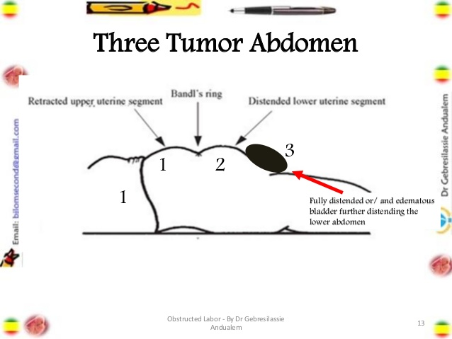
Obstructed Labor

Slide 35
Obstructed Labor
Physical Examination
  Vaginal examination
    Foul-smelling meconium and dry vagina
    Vaginal bleeding after rupture of the uterus…tamponad effect
    Catheterization can be difficult---contain meconium or blood
    Edema of the vulva and cervix following prolonged pushing down and labor

Slide 36
Obstructed Labor
Vaginal examination
  Depending on the cause of the obstruction, there may be:
    Large caput succedaneum in CPD
    Shoulder with or without prolapsed arm
    Brow
    Face presentation in mentoposterior

Slide 37
Obstructed Labor
Document review ----partograph (what do you think the partograph looks like?)
Investigations
  Occasional paracentesis
  preoperative assessment and evaluation:
    Hemoglobin/ Hct
    Blood group (ABO, Rh)
    Urine analysis
    Renal function tests (especially with decreased urine output)
    Blood culture and sensitivity
    Others test depending on individual clinical findings

Slide 38
Obstructed Labor (OL)
Treatment Plan
  Resuscitation and monitoring of the life endangering conditions such as shock, sepsis
  Identifying the cause of OL and other complications and treating accordingly
  Sepsis:
    signs of infection, or the membranes have been ruptured for 12 hours or more
      Triple IV antibiotics (Ampicillin, Gentamycin, and Metronidazole)

Slide 39
Obstructed Labor
Mode of Delivery in OL:
  Intact uterus with no imminent rupture --- CS vs operative vaginal delivery
  Imminent uterine rupture --- CS vs destructive for dead fetus
  Ruptured uterus
    Repair vs hysterectomy

Slide 40
Obstructed Labor
Postoperative care and follow up
  Intensive resuscitation and monitoring should be continued till condition improves
  Blood transfusion
  Antibiotics IV till fever free for 2-3 days and continue coarse PO
  Investigation including blood and urine culture

Slide 41
Obstructed Labor
Postoperative care and follow up
  Analgesics including pethidine
  Breast care for those with stillbirths or neonatal deaths
  Close monitoring to identify complications early
  Explain condition and counsel on future pregnancy
  Fistula care and follow-up

Slide 42
Induction and Augmentation of labor
Induction of labor is the artificial stimulation of uterine contractions before the spontaneous onset of true labor at 28 or more weeks of gestation to achieve vaginal delivery
Induction methods
  Surgical methods: ARM, ballooned catheter, laminaria
  Medical, pharmacological induction: Oxytocin, prostaglandins such as misopristone

Slide 43
Induction of Labor
Indications
  Preeclampsia, eclampsia, chronic hypertension
  Diabetes mellitus
  PROM
  Chorioamnionitis
  Abruptio placentae
  Post-term pregnancy
  Congenital abnormality

Slide 44
Induction of Labor
Indications continued
  IUFD
  Previous stillbirth
  Rh isoimmunization
  IUGR
Contraindications
  Contraindications for labor or vaginal delivery
  Contraindications to oxytocin use, Contraindication for ARM

Slide 45
Induction of Labor
Prerequisites
  Valid indication for induction and termination
  No contraindication
  Elective induction
    What further prerequisites are needed for elective induction?

Slide 46
Induction of Labor
Prerequisites continued
  Elective induction
    lung maturity
      Lecithin/Sphingomyelin Ratio ≥ 2
      Slide Agglutination Test for Phosphatidylglycerol > 0.5 mg/ml of amniotic fluid
      TDx Test (Surfactant Albumin Ratio) value of --70 vs 55
      Lamellar Body Counts-- >30,000 to 55,000/ml is highly predictive of pulmonary maturity
    Bishop Score of favorable cervical condition

Slide 47
    Bishop Score
Score | Dilation | Effacement (%) | Station | Consistency | Position
0 | Closed | 0-30 | -3 | Firm | Posterior
1 | 1-2 | 40-50 | -2 | Medium | Mid position
2 | 3-4 | 60-70 | -1,0 | Soft | Anterior
3 | ≥5 | ≥ 80 | +1, +2

Slide 48
Bishop Score
Interpretation of the Bishop’s score:
  Score ≤ 4: Unfavorable cervix is unlikely to yield for induction; Cervical ripening is needed for success with induction. Postpone induction for next week if possible or use cervical ripening and plan induction for next day.
  Score 5-8: Intermediate
  Score = 9: Favorable cervical condition and induction is likely to succeed. There is no need for cervical ripening. Induction using Oxytocin can be planned for next day

Slide 49
Bishop Score
Methods of cervical ripening
  Vaginal misoprostol of 25 mcg is placed into the upper vagina and repeated after 6 hours. If there is no response after 2 dozes of 25 mcg, the dose is increased to 50 microgram every 6 hours for a total of 200 mcg.
  Stripping of membrane
  Folly catheter
    size16 or 18, inflated with 30 -50 ml of sterile saline

Slide 50
Induction of Labor
Protocol for induction and augmentation varies from hospital to hospital.
In this presentation we will discuss based a 2010 updated management protocol on selected obstetrics topics and IMPAC 2017.
However, practitioners have to obey a protocol of specific hospital in which they are assigned to practice.

Slide 51
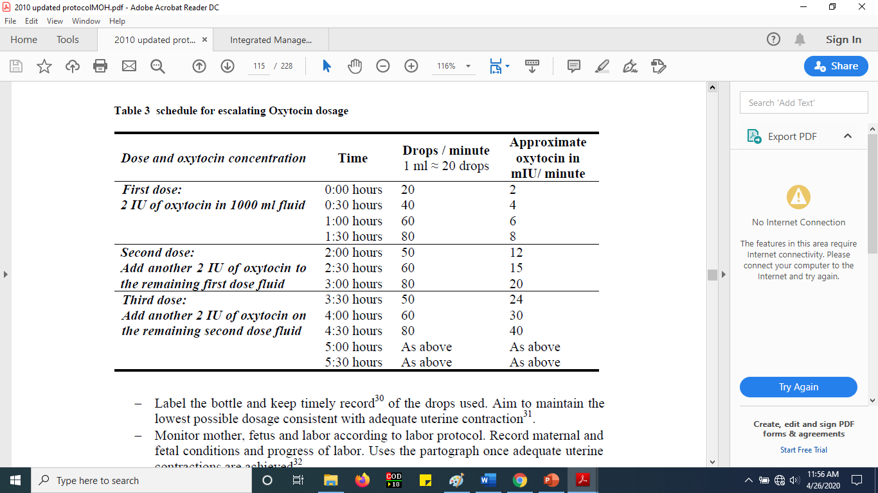
Induction of Labor
According to this protocol oxytocin infusion is same for augmentation

Slide 52
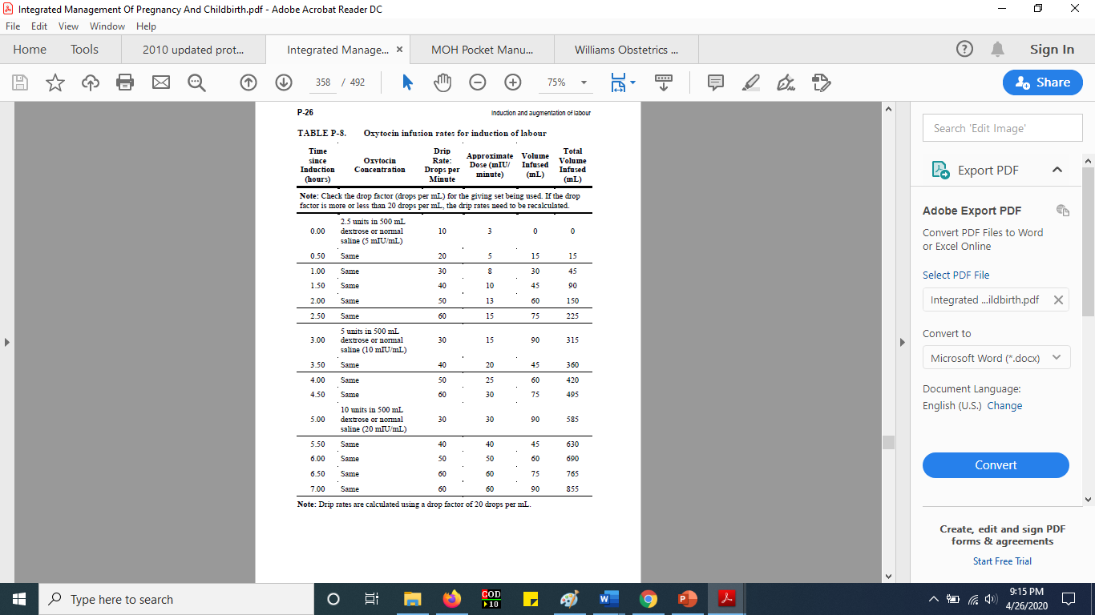
Induction of Labor
Increase the rate of oxytocin infusion only to the point where a good contraction pattern (three contractions in 10 minutes, each lasting more than 40 seconds) is established; then maintain the infusion at that rate but continue to monitor the woman and fetus and respond immediately if there are signs of hyperstimulation or fetal distress.

Slide 53
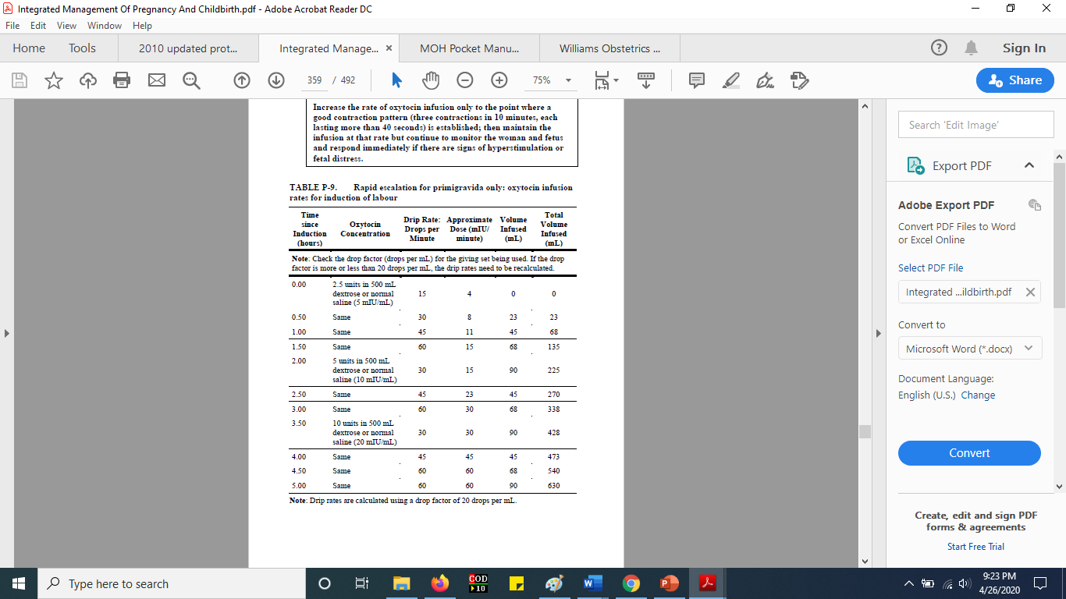
Induction of Labor
Rapid escalation for primigravida only: oxytocin infusion rates for induction of labour

Slide 54
Induction of Labor
In a protocol believed to be of Jimma University specialized hospital the following is presented.
Oxytocin infusion:
  Secure intravenous line with number 18 cannula
  Dosage is the same for primigravida and multigravida
  Increase the drop rate every 20 minutes until 3-5 contractions are achieved in 10 minutes each lasting for 40-60 seconds.

Slide 55
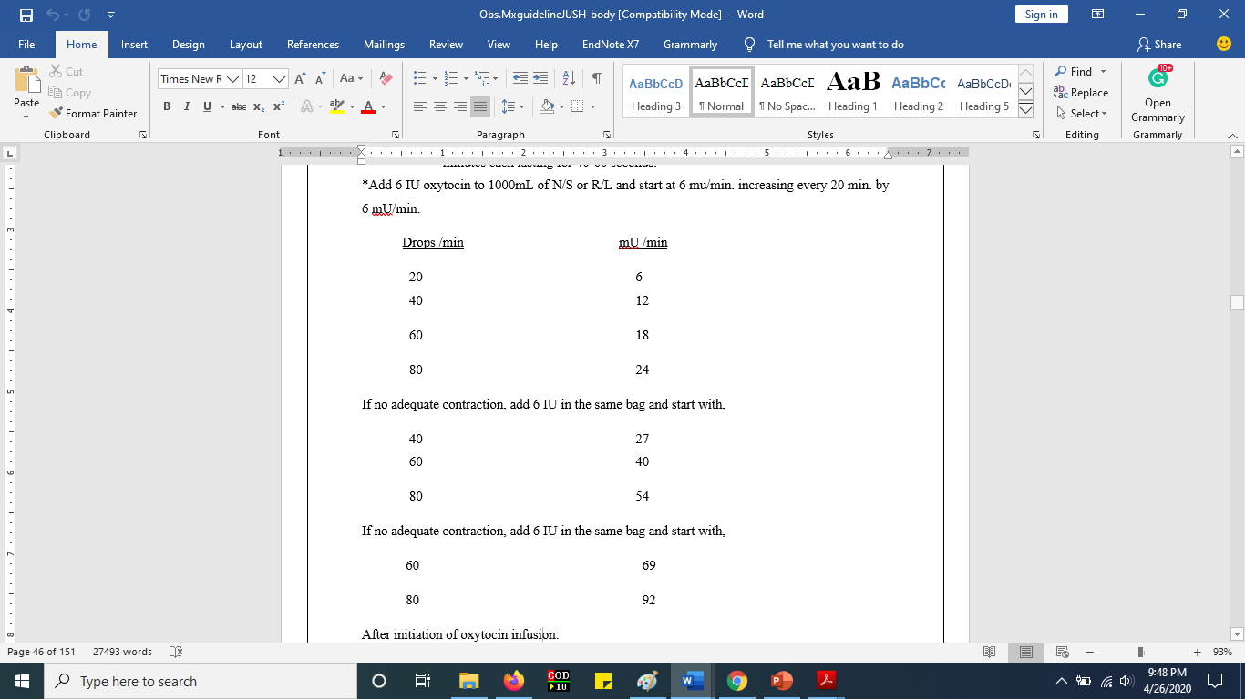
Induction of Labor

Slide 56
Induction of Labor
In hospitals where I engaged in clinical practice we followed the following approach:
For induction of nullipara mothers
  Starting dose 5IU of oxytocin in 1000 ml of NS (20, 40, 60, & 80 drops/min/20 minutes)
  Add 5IU oxytocin in the same bag (40, 60, & 80 drops/min/20 minutes)
  Add another 5IU oxytocin in the same bag (60 & 80 drops/min/20 minutes)
For induction of multiparous mothers, same approach but:
  Half the dose of nullipara mother that is 2.5IU of oxytocin in 1000 ml

Slide 57
Failed induction
Failure to initiate good uterine contraction.
  It is diagnosed if adequate uterine contractions are not achieved after 6 to 8 hours of oxytocin administration and use of the maximum dose for at least one hours.
Failed induction: up-to-date
  Failure to generate regular contractions approximately every three minutes and cervical change after at least 24 hours of oxytocin administration
  failure to generate regular contractions and cervical change with oxytocin administration for 12 hours after rupture of membranes

Slide 58
Augmentation of labor
stimulation of the uterus to increase its frequency, duration and/or strength of spontaneously initiated labor.
The methods for augmentation are ARM and oxytocin
In my experience
  We were using half of the dose of induction (2.5IU oxytocin for nullipara and 1.25IU oxytocin for multiparous mothers)

Slide 59
Assignment for further discussion
What would you do if the bag of fluid for induction/augmentation is completed before delivery of the fetus happens?
When do we stop infusion?

Slide 60
References
Williams Obstetrics 24th edition
Ministry of Health EFDR, Management protocol on selected Obstetrics topics, 2010
Managing complications in pregnancy and child birth: a guide for Midwives and doctors, IMPAC 2017

